Slide 1
Sound in Matlab & Cogent
Tobias Overath

Slide 2
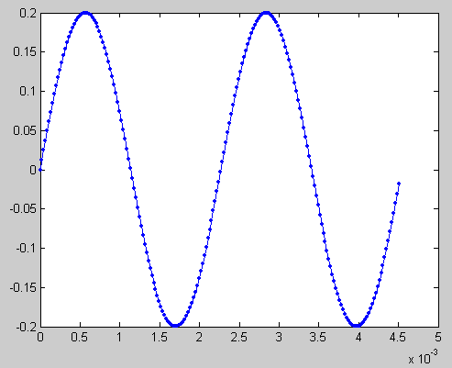
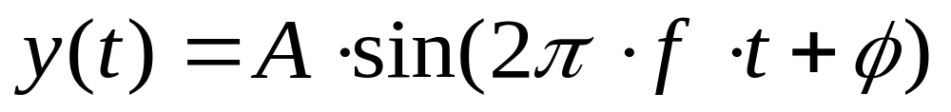
Sound
sound = pressure wave

Slide 3
Overview
play sound in Matlab/Cogent
create a sound
things you can do with sound:
  louder/quieter
  higher/lower
  combine sounds
compose & play a melody

Slide 4
Playing a sound in Matlab
load wavfile
  y = wavread(‘filename.wav’);
play wavfile
  sound(y,Fs)
    if unsure which Fs
      [y, Fs, nbits, opts] = wavread(‘filename.wav’)
write to disk
  wavwrite(y,Fs,’filename.wav’)

Slide 5
Playing a sound in Cogent
config_sound(nchannels,nbits,Fs,nbuffs)
  nchannels: 1 = mono, 2 = stereo
  nbits: e.g. 16
  Fs: sampling frequency (e.g. 44100)
  nbuffs: number of buffers
wavfilename = [‘filename.wav’];
loadsound(wavfilename, buffer number)
playsound(buffer number)
waitsound(buffer number)
  otherwise next command will be executed immediately)

Slide 6
creating a sound in Matlab
Fs = 44100;
t = [0:1/Fs:1-1/Fs]; %1 second, length 44100
freq = 400; % Hz
f1 = sin(2*pi*freq*t);
  sound(f1,Fs)
f2 = sin(2*pi*(2*freq)*t);
  sound(f2,Fs)
period: 1/freq (*Fs)
figure(1);plot(f1)
figure(2);plot(f1(1:round(1/freq*Fs+1)))

Slide 7
play consecutively
  f12 = [f1 f2];
  sound(f12,Fs)
play together/superimposed:
  f_12 = [f1+f2];
    or:
      f_12 = sum([f1;f2]);
  sound(f_12,Fs);

Slide 8
making a sound louder/quieter
f = sin(2*pi*freq*t)
  standardise sound
    f = f-mean(f);
    f = f/std(f);
scale sound
  amplitude = .2;
  f = amplitude * f;
10^±0.5 for every 10dB
  e.g. 10^1.0 → 20 dB louder
  e.g. 10^-1.5 → 30 dB quieter
    do not be put off by warning ‘data clipped’ message. Wavwrite needs an input vector in the range –1 to +1, else it will clip. The warning means that you have sounds that are 1 or –1 but the clipping will leave them unaltered

Slide 9
create noise
y = .2*randn(1,Fs);
sound(y,Fs)

Slide 10
FM sweep
f = chirp(t1,f1,t2,f2);
  t1 = vector t = [0:1/Fs:1-1/fs];
  f1 = initial frequency
  f2 = final frequency
  t2 = time at which f2 is reached
f = chirp(t,freq,1,2*freq);
sound(f,Fs)

Slide 11
AM sound
freq = 400; % carrier frequency
fm = 10; % modulation frequency
f_c = sin(2*pi*freq*t);
f_m = sin(2*pi*fm*t);
f_mod = [f_c .* f_m];
sound(f_mod,Fs)

Slide 12
square wave
x = square(t,duty cycle)
  duty cycle = % of signal that’s positive
freq = 10;
fsq = square(2*pi*freq*t);
fsq = square(2*pi*freq*t, 80);

Slide 13
plot signal
plot(t,f)

Slide 14
scale
12-split equitempered octave
  f(n) = sin(2*pi*freq*2^(n/12)*t)
  for example
    n=[0:12]; % 12 semitones
    for i=1:length(n)
    f(i,:) = sin(2*pi*freq*2^(n(i)/12)*t);
    end
    fs=[];
    for i=1:13
    fs = [fs f(i,:)];
    end
    fs=fs-mean(fs);
    fs=fs/std(fs);
    fs=.2*fs;
    sound(fs,Fs)

